Slide 1
Compare & Contrast
Mesopotamia | Same | Egypt
Had 2 rivers that flooded – Tigris & Euphrates | Both rely on flooding to deposit silt for farmland | Was a 1 river civilization – Nile River
Thought that the gods appointed the king in charge. | People are polytheistic – they worship many gods | Thought that their king was part god.
Built walls around city-states for protection | Both were empires at some point in history Egypt – New kingdom. | Had natural boarders to protect – desert & seas
Could not predict the floods of the rivers *Ziggurats | Religion is the center of life – temples were built dedicated to the gods | Could predict the flood of the Nile – summer time *Pyramids

Slide 2
Egypt Land of Pharaohs Study Guide

Slide 3
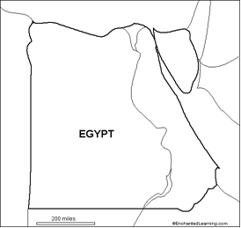

Slide 4
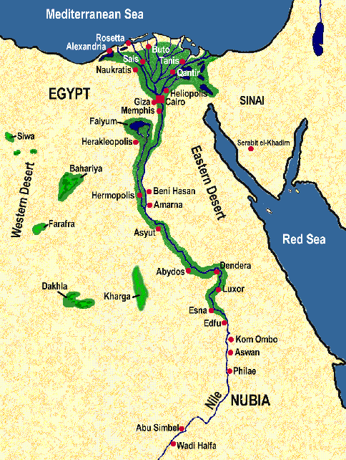

Slide 5
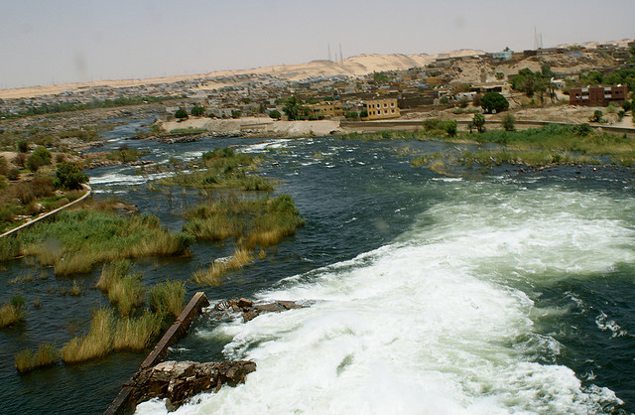
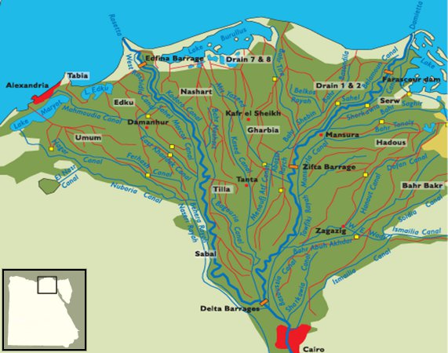
Vocabulary
Cataracts – rushing rapids along the Nile River-white-water rapids
Delta – a triangle shaped area of land made from soil deposited from a river

Slide 6
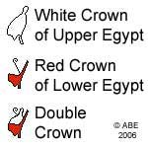

Vocabulary
Pharaoh – the title used by the kings of Egypt-believed to be part god and part human
Dynasty – a series of rulers from the same family

Slide 7
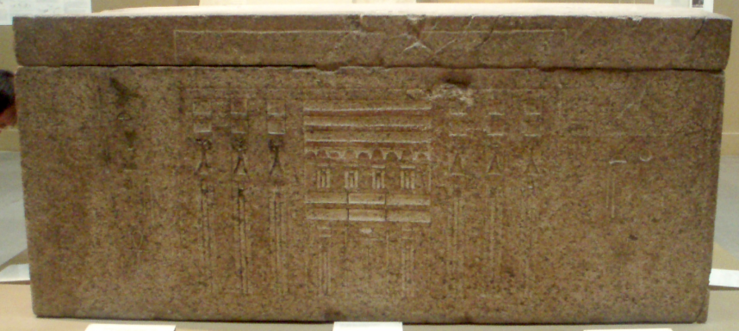
Vocabulary
Afterlife – life after death, much of Egyptian religion focused on the afterlife
Mummies – a specially treated body wrapped in cloth for preservation
Sarcophagus – a case which contained the preserved mummy-like a casket today
Ka – Ancient Egyptians believed that ka was a person’s life force-the ka had all the same needs that the person had when she or he was living (much like a spirit)

Slide 8
Vocabulary
Pyramid – huge triangular tomb build by the Egyptians and other peoples
Hieroglyphics –the ancient Egyptian writing system that used picture symbols
Papyrus – long-lasting paper like material made from reeds that the ancient Egyptians used to write on

Slide 9
People to Know:
Menes - Legendary Egyptian ruler, he unified the kingdoms of Upper and Lower Egypt and built the new capital city of Memphis
King Tutankhamen – Egyptian pharaoh, he died while still a young king. The discovery of his tomb (Valley of the Kings) in 1922 has taught archaeologists much about Egyptian culture.

Slide 10
Short Answer Questions
1. A pharaoh was considered ½ human/king and ½ God
2. Egypt was split into 3 time periods – Old, Middle & New kingdoms
2. Who did people blame if the crops did not grow? The Pharaoh

Slide 11
Short Answers
1. Why was Egypt called the gift of the Nile?
Because it gave life to the desert due to flooding—fertile soil. The floods deposited silt – this allowed the Egyptians to farm and live there.
2. What are the natural barriers that made Ancient Egypt a difficult place to invade? (2 needed) Be sure to explain.
Cataracts-strong rapids throughout the Nile made it hard to invade
Desert to the east and west made it hard to invade (Western and Eastern Desert);
The seas to the north (Mediterranean).
All created natural barriers making Egypt hard to invade.

Slide 12
Short Answers
3. Why did Egyptians mummify their dead?
This preserved the body and was needed to prepare their body for the afterlife-Egyptians believed that if the body wasn’t mummified, their soul - ka - would not be able to recognize their body and spend eternity searching for it (thus missing their afterlife)
4. Describe (with at least two details) the general religious beliefs of ancient Egypt
Polytheistic (explain) Gods often shown to have to have human body & head of an animal
Focus on the afterlife (explain)
Weighing of the Heart Ceremony

Slide 13

Short Answers
5. Why did pharaohs wear a double crown?
A double crown was worn to symbolize their ruler over both upper and lower Egypt. Menes was the first to combine the crown.
6. How were the pharaohs able to pay for the pyramids?
The pharaohs paid for the pyramids with taxes. They heavily taxed the Egyptians. Eventually, this caused the pharaoh to lose power and for the nobles to take over due to the economic crisis that it caused.
7. Why is the Rosetta Stone so important?
The Rosetta Stone allowed modern people to read Egyptian hieroglyphics which had not been understood for around 1,500 years. Because of this, historians can now learn much more about the cultural aspects of ancient Egypt.

